Slide 1
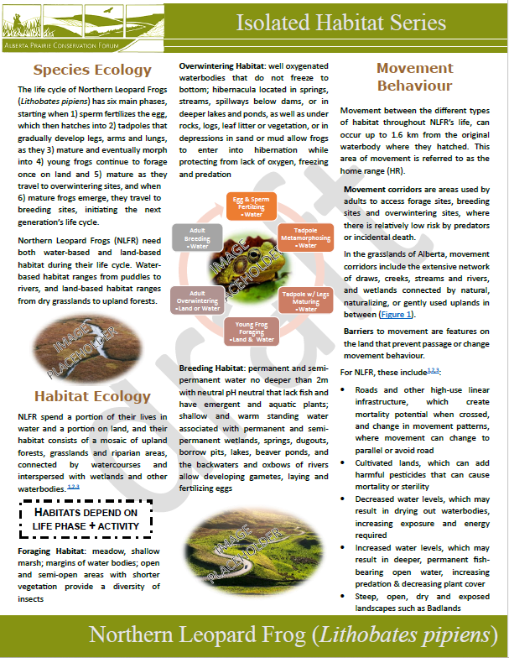
Prairie Conservation Forum’s Grassland Species-at-risk Isolated Habitat Mapping Framework
In 2020, the Prairie Conservation Forum (PCF) published the Alberta Prairie Conservation Action Plan, which identified the goal of protecting isolated native prairie habitat by linking to management and planning, as well as to government and landowners.
To support this, the PCF created a grassland species-at-risk (SAR) isolated habitat mapping framework (Framework) that serves as a terms of references for mapping projects, and instructions to guide Mappers through project development. The Framework provides a scientific-based approach that addresses limitations associated with mapping and sensitive data. Output from each mapping project was tailored to PCF’s Connectivity Portal, where land users can explore map layers to see where land uses and land cover connect.
Burrowing Owl
Endangered in Alberta
Isolated Habitat Maps provide a generalized location, within which suitable habitat is likely to occur, but specific types or density of land use activities or land cover features may create physical barriers to movement, or change natural movement behaviour in plant, animal and insect SAR at a sensitive time in their life cycle.
Landowners and land users that are interested in learning more about any of the isolated habitat layers can access infographics for each SAR on PCF’s website. These infographics describe the species and its habitat, as well as what was considered an isolating condition.
Grassland Species-at-risk Isolated Habitat Map Production
Start Project
Step 2: Mapping/ Modelling Inputs
Study SAR
Isolated habitat
Habitat connectivity
Sensitive data
Step 3: Run Model/Map
Attributes
Spatial analysis
Pre-processing/ Standardization
Movement behaviour
Habitat patch
Species habitat
Ecologically-relevant inputs
Parameters
Documentation
Life cycle
Life phase
Data use licenses
Project Tracking
Step 1: Define Study Question
Step 4: Post-production
SpeciesDB
Mapper Templates
Project Tracking
Quality control
Metadata
Output Maps
Reports
Adaptive Management - Update
Mapper Tools
Framework
Tool
Species DB
User needs
Report Template
Framework

Slide 2
Prairie Conservation Forum’s Grassland Species-at-risk Isolated Habitat Modelling Framework
Terms of Reference
The Framework includes standards for Mappers when completing a mapping project, as well as the PCF Board of Directors when managing multiple Mappers and multiple SAR. Standards within the Framework ensure due diligence is followed during all species mapping projects, as well as consistency with all output products.
To support this, the PCF has created a grassland species-at-risk isolated habitat mapping framework (Framework) that included:
Definitions of isolated habitat,
Priority list of grassland species-at-risk (SAR) in Alberta,
Standards for mapping isolated habitat,
A Quality Assurance process that ensures consistent documentation of data inputs, processing and outputs, so that the project can be duplicated by another Mapper, and
Mapper templates that provide detailed terms of reference/scope.
From an organizational perspective, digital product standards reduce the liability of creating or distributing/sharing potentially sensitive information, such as that associated with SAR. Management of these issues includes post-production attribution, such as adding disclaimers and terms of use. Sensitive data needs to be presented in accordance with data sharing agreements, as well as potential issues with any recommendations provided in associated reports.
Burrowing Owl
Endangered in Alberta
FRAMEWORK for map production & management
Start Project
Step 2: Mapping/ Modelling Inputs
Study SAR
Isolated habitat
Habitat connectivity
Sensitive data
Step 3: Run Model/Map
Attributes
Spatial analysis
Pre-processing/ Standardization
Movement behaviour
Habitat patch
Species habitat
Ecologically-relevant inputs
Parameters
Documentation
Life cycle
Life phase
Data use licenses
Project Tracking
Step 1: Define Study Question
Step 4: Post-production
SpeciesDB
Mapper Templates
Project Tracking
Quality control
Metadata
Output Maps
Reports
Adaptive Management - Update
Mapper Tools
Framework
Tool
Species DB
User needs
Report Template
Framework

Slide 3
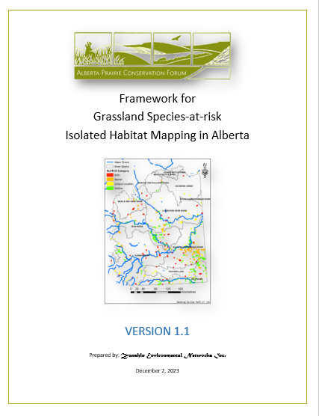
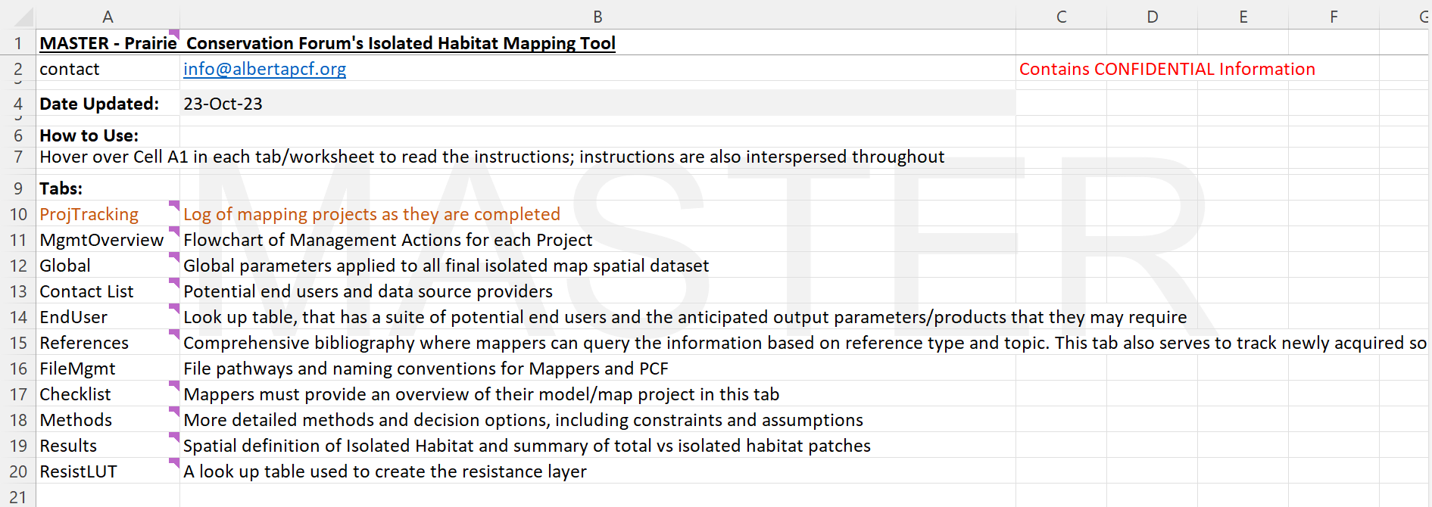
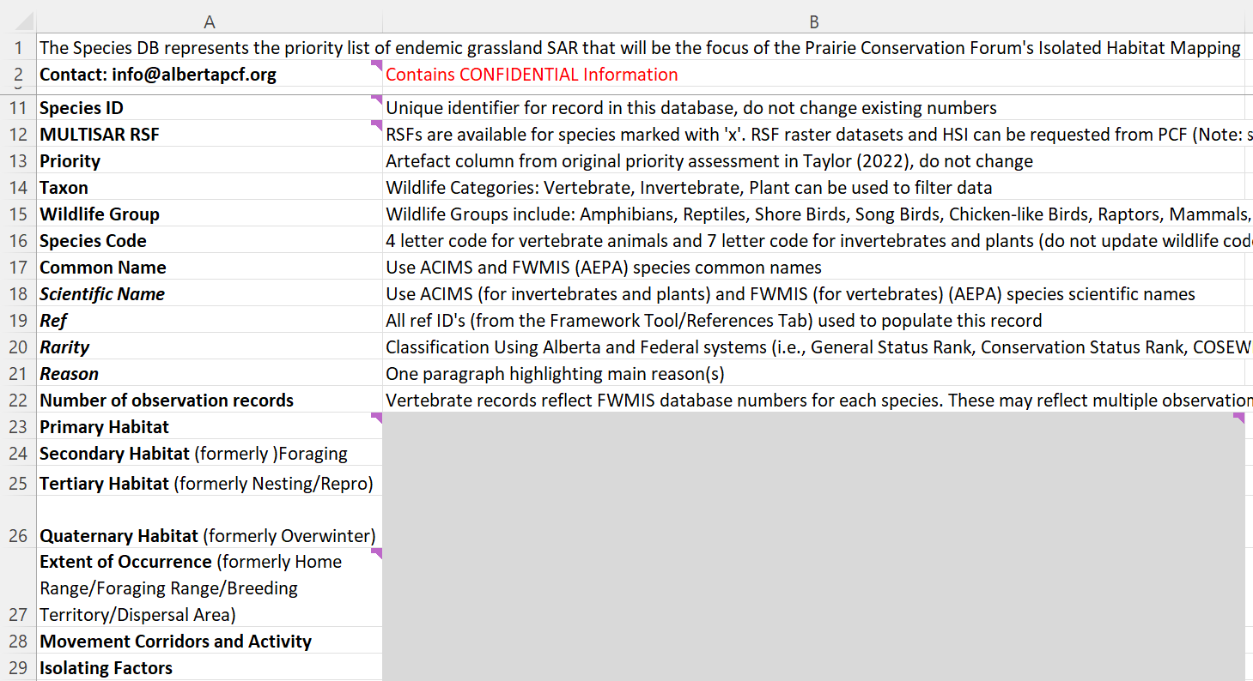
Framework Framework Tool SpeciesDB Report Template

